Slide 1

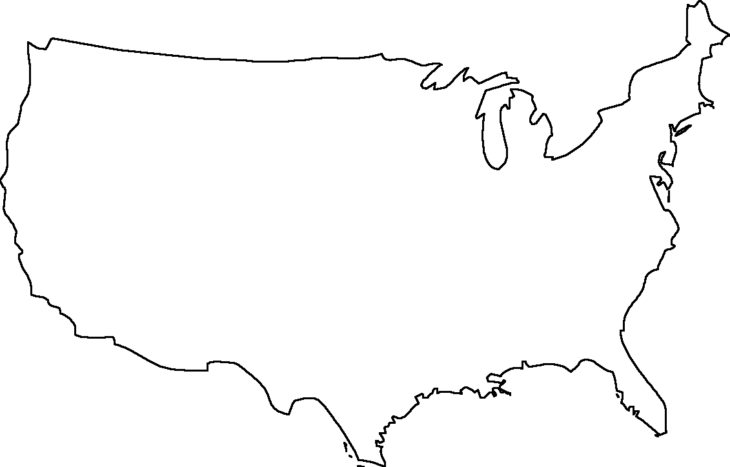
US programs in Bioinformatics
Harvard | P+D+I
MIT | I+D
Brown | C+P
For more information see: http://blog.gerstein.info/2014/05/updated-listing-of-us-programs-in.html
Dartmouth | C
Yale | P+T+i
Cornell | P
Columbia | D+C+P
P=program
D=department
C/I=center / instatute
G=Research Group Only
Princeton | P+I((F)
UW | P
Penn | P
UC San Francisco | P+I
UC Berkely | P+C
Stanford | P+d
JHU | C
UC Santa Cruz | P
Caltech | G
USC | P
UC Los Angeles | P
Rice U | P+G
Baylor | P
MD Anderson | D+P
UC San Diego | D+P

